Slide 1
C CLEAN CODE & LESSON LEARNS TRUNG TRAN (RBVH/ECM1)

Slide 2
Outline
Spaghetti Code
Martin Fowler’s Quote
Clean Code Reference
Coding Conventions
Programming Style
Naming Convention
Function Parameters
Avoid Hard code/Magic number
Code Comment & Self-document Code
Condition Order Of “if/else”
Avoid “do/while”
Use Demonstration Variable
Use Summary Variable
Use De Morgan Law
Operator Precedence
Avoid Deep Nesting
Reference vs Pointer
Pointer With const
Macro vs Inline Function
Memory Leak, Core Dump
Problems
60* countries –
410,000* Bosch associates

Slide 3
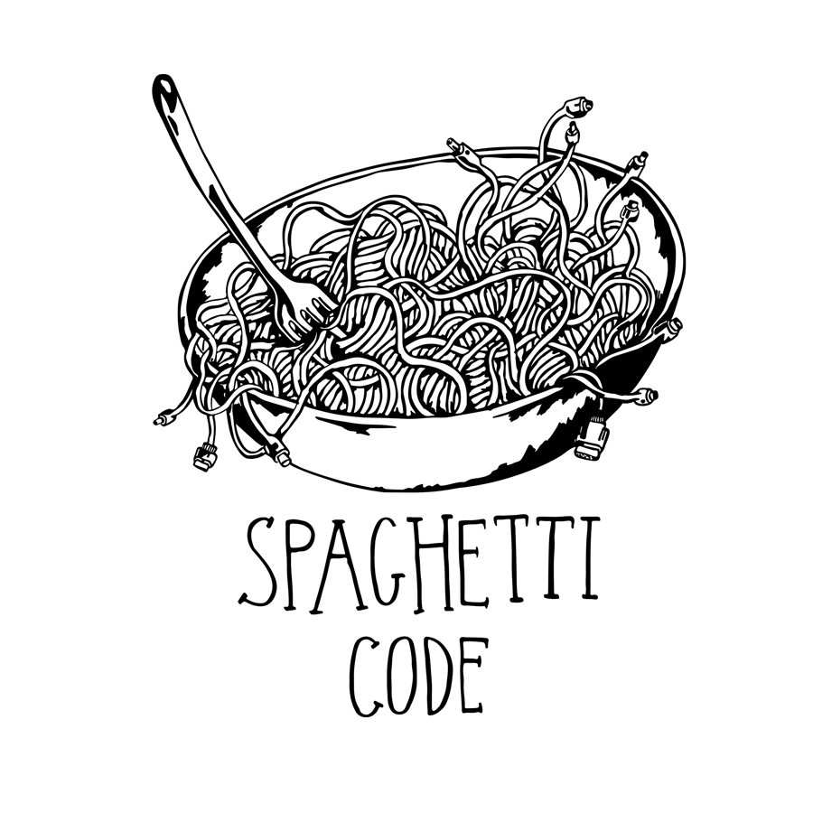
Spaghetti Code
Spaghetti code is a pejorative phrase for unstructured and difficult-to-maintain source code. Spaghetti code can be caused by several factors, such as volatile project requirements, lack of programming style rules, and software engineers with insufficient ability or experience
60* countries –
410,000* Bosch associates
440 regional subsidiaries

Slide 4
Spaghetti Code
int calcArea(int height, long width) {
int rect_area = -1;
if ((0 < height) && (0<width))
{
rect_area = height* width;
}
return rect_area;
}
int main(int argc, char* argv[])
{
int rectArea = calcArea(4, 6);
return 0;
}
60* countries –
410,000* Bosch associates
440 regional subsidiaries

Slide 5
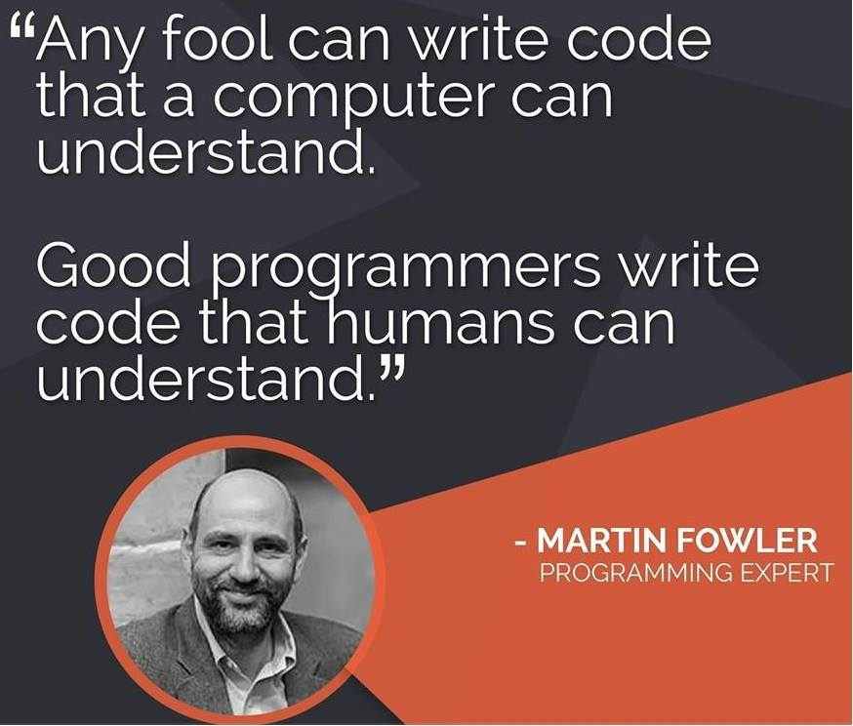
Martin Fowler’s Quote
Martin Fowler
60* countries –
410,000* Bosch associates
440 regional subsidiaries

Slide 6
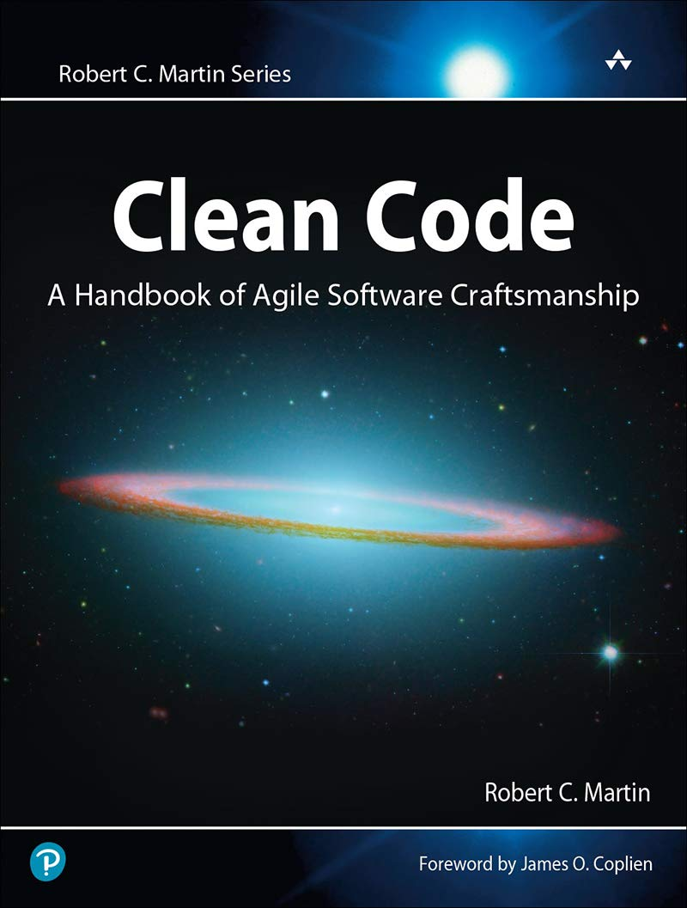
Clean Code Reference
Robert C.Martin
60* countries –
410,000* Bosch associates
440 regional subsidiaries

Slide 7

Coding Conventions
Coding conventions are a set of guidelines for a specific programming language that recommend programming style, practices, and methods for each aspect of a program written in that language. These conventions usually cover file organization, indentation, comments, declarations, statements, white space, naming conventions, programming practices, programming principles, programming rules of thumb, architectural best practices, etc
60* countries –
410,000* Bosch associates
440 regional subsidiaries

Slide 8
Programming Style
Programming style, also known as code style, is a set of rules or guidelines used when writing the source code for a computer program. It is often claimed that following a particular programming style will help programmers read and understand source code conforming to the style, and help to avoid introducing errors
LLVM: A style complying with the LLVM coding standards
Google: A style complying with Google’s C++ style guide
Chromium: A style complying with Chromium’s style guide
Mozilla: A style complying with Mozilla’s style guide
Microsoft: A style complying with Microsoft’s style guide
GNU: A style complying with the GNU coding standards
60* countries –
410,000* Bosch associates
440 regional subsidiaries

Slide 9
Naming Convention
Class/Struct/Object:
The name should be a noun or noun phrase. E.g: Account, Customer, Client, …
Method/Function:
Should start with a verb or verb phrase. E.g: postPayment(), deleteUser(), saveScore(), …
It’s smallest as possible to solve a unique problem, this will help to read code and re-use method/function more easily
Single-responsibility principle
60* countries –
410,000* Bosch associates
440 regional subsidiaries

Slide 10


Naming Convention
int calc(int w, int h)
{
return w * h;
}
60* countries –
410,000* Bosch associates
440 regional subsidiaries
int calcRectangleArea(int rectWidth, int rectHeight)
{
return rectWidth * rectHeight;
}

Slide 11
Function Parameters
The function parameters should be less than or equal 3
When function needs the parameters which greater than 3, we should encapsulate the parameters to a class or a struct
60* countries –
410,000* Bosch associates
440 regional subsidiaries

Slide 12
Function Parameters
void doHomeWork(math, physic, chemical, biology, …);
Struct Subject
{
math;
physics,
chemistry,
biology,
...
};
void doHomeWork(struct Subject subject);
60* countries –
410,000* Bosch associates
440 regional subsidiaries

Slide 13

Avoid Hard Code/Magic Number
Avoid the obscurity and the questions for the reader: What these values?, Where do they come from?, ...
60* countries –
int getDiscountPrice(int productNumber)
{
if (10 <= productNumber)
{
return 75;
}
else
{
return 100;
}
}
410,000* Bosch associates
440 regional subsidiaries

Slide 14
Avoid Hard Code/Magic Number
const int PRODUCT_NUM_FOR_DISCOUNT = 10;
const int DISCOUNT_PRICE = 75;
const int ORIGINAL_PRICE = 100;
int getDiscountPrice(int productNumber)
{
if (PRODUCT_NUM_FOR_DISCOUNT <= productNumber)
{
return DISCOUNT_PRICE;
}
else
{
return ORIGINAL_PRICE;
}
}
60* countries –
410,000* Bosch associates
440 regional subsidiaries

Slide 15
Code Comment & Self-document Code
Self-document code:
// The function calculates the area of a rectangle
// Param w: the width of the rectangle
// Param h: the height of the rectangle
// Return: int
int calc(int w, int h)
{
return w * h;
}
60* countries –
410,000* Bosch associates
440 regional subsidiaries
int calcRectangleArea(int rectWidth, int rectHeight)
{
return rectWidth * rectHeight;
}

Slide 16
Condition Order Of “if/else”
Should set positive condition before negative condition
Should set simple condition and quick result first
Should set important, more meaningful condition first
60* countries –
410,000* Bosch associates
440 regional subsidiaries

Slide 17
Condition Order Of “if/else”
if (a != expectedValue)
{
...
return null;
}
else
{
...
return expectResult;
}
60* countries –
410,000* Bosch associates
440 regional subsidiaries

Slide 18
Condition Order Of “if/else”
if (a == expectedValue)
{
...
return expectResult;
}
else
{
...
return null;
}
60* countries –
410,000* Bosch associates
440 regional subsidiaries

Slide 19
Condition Order Of “if/else”
If true/false probability of the child conditions is the same, should place simple and faster processing conditions first. Place complex and longer processing conditions after that
60* countries –
410,000* Bosch associates
if ((2 == object.getValue()) && (1 == receivedValue))
{
...
}
440 regional subsidiaries
if ((1 == receivedValue) && (2 == object.getValue()))
{
...
}

Slide 20
Condition Order Of “if/else”
If true/false probability of the child conditions is different:
AND operator (A && B): Set the condition which has “false” probability first -> If A is “false”, the condition will end, does not care about B
OR operator (A || B): Set the condition which has “true” probability first -> If A is “true”, the condition will end, does not care about B
60* countries –
410,000* Bosch associates
440 regional subsidiaries

Slide 21
Avoid “do/while”
We easily get the mistake in the first "do", because we do not check the condition
int counter = 0;
do
{
int sum = 0;
sum += (5 / counter);
counter++;
}
while((counter > 0) && (counter < 5));
60* countries –
410,000* Bosch associates
440 regional subsidiaries

Slide 22
Use Demonstration Variable (Biến thuyết minh)
Demonstration variable is used to store the mediate value
It helps the readers read the logic condition quickly and understand the logic of the implementation
60* countries –
410,000* Bosch associates
440 regional subsidiaries

Slide 23
Use Demonstration Variable (Biến thuyết minh)
if (line.split(':')[0].strip() == "root")
{
...
}
60* countries –
410,000* Bosch associates
440 regional subsidiaries
username = line.split(':')[0].strip()
if (username == "root")
{
...
}

Slide 24
Use Summary Variable (Biến tóm lượt)
We should use summary variable to easily the implementation and fix the code more quickly
if (request.user.id == document.owner_id)
{
// User can edit this document
}
...
if (request.user.id != document.owner_id)
{
// User only can read this document
}
60* countries –
410,000* Bosch associates
440 regional subsidiaries

Slide 25
Use Summary Variable (Biến tóm lượt)
bool userOwnsDocument = (request.user.id == document.owner_id);
if (userOwnsDocument)
{
// User can edit this document
}
...
if (!userOwnsDocument)
{
// User only can read this document
}
60* countries –
410,000* Bosch associates
440 regional subsidiaries

Slide 26
Use De Morgan Law
not (a or b or c) <=> (not a) and (not b) and (not c)
not (a and b and c) <=> (not a) or (not b) or (not c)
60* countries –
if (!(fileExists && (!isProtected)))
{
printf(Sorry, could not read file);
}
410,000* Bosch associates
440 regional subsidiaries
if ((!fileExists) || isProtected))
{
printf(Sorry, could not read file);
}

Slide 27
Operator Precedence
int main(int argc, char* argv[])
{
bool flag = 1 > 2 + 3 && 4; // true or false???
return 0;
}
60* countries –
410,000* Bosch associates
440 regional subsidiaries
int main(int argc, char* argv[])
{
bool flag = (1 > (2 + 3)) && 4; // false
return 0;
}

Slide 28
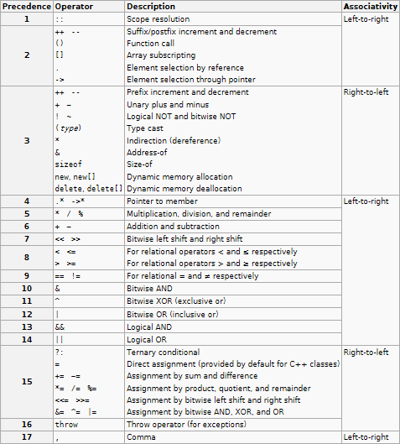
Operator Precedence
60* countries –
410,000* Bosch associates
440 regional subsidiaries

Slide 29
Avoid Deep Nesting
void doStuff() {
if (isWritable(folderName)) {
if (isOpenable(filePath)) {
if (doSomeStuff()) {
if (fwrite()) {
// ...
} else {
return false;
}
} else {
return false;
}
} else {
return false;
}
} else {
return false;
}
}
60* countries –
410,000* Bosch associates
440 regional subsidiaries

Slide 30
Avoid Deep Nesting
void doStuff() {
if (!isWritable(folderName)) {
return false;
}
if (!isOpenable(filePath)) {
return false;
}
if (!doSomeStuff()) {
return false;
}
if (fwrite()) {
// ...
}
else {
return false;
}
}
60* countries –
410,000* Bosch associates
440 regional subsidiaries

Slide 31
Reference vs Pointer
Problem: There are 2 variables a and b with the same value. How can we change the value of a, the value of b will be changed immediately
int main(int argc, char* argv[])
{
int a = 5;
int &b = a;
a = 8;
std::cout << a;
std::cout << b;
}
60* countries –
410,000* Bosch associates
440 regional subsidiaries

Slide 32
Reference vs Pointer
Reference | Pointer
int a; int& b = a; | int a; int* b = &a;
A reference (or alias) for a | A pointer to variable a (or store address of a)
C++ | C/C++
Must be assigned when declare, can NOT be re-assigned | Can be assigned or NOT when declare, can be re-assigned
Shares the same memory address (with the original variable) | Has its own memory address and size on the stack
Can NOT be assigned to nullptr | Can be assigned to nullptr
One level of indirection | Extra levels of indirection
Used in function parameters and return types. | Used in pointer arithmetic or passing NULL-pointer is needed, implemented data structures like linked list, tree, …
60* countries –
410,000* Bosch associates
440 regional subsidiaries

Slide 33
Pointer With const
Pointer | With const | Address that points to | Value of address that points to
Pointer to constant | const int* ptr; | Yes | No
Constant pointer | int* const ptr; | No | Yes
Constant pointer to constant | const int* const ptr; | No | No
60* countries –
410,000* Bosch associates
440 regional subsidiaries
int main(int argc, char* argv[])
{
int a = 5;
const int* ptr = &a;
(*ptr)++;
}
// error here

Slide 34
Pointer With const
int main(int argc, char* argv[])
{
int a = 5;
int b = 7;
int* const ptr = &a;
ptr = &b;
}
60* countries –
410,000* Bosch associates
// error here
440 regional subsidiaries
int main(int argc, char* argv[])
{
int a = 5;
int b = 7;
const int* const ptr = &a;
(*ptr)++;
ptr = &b;
}
// error here
// error here

Slide 35
Macro vs Inline Function
#define SQUARE(a) ((a)*(a))
inline int square(a)
{
return a * a;
}
int main(int argc, char* argv[])
{
std::cout << SQUARE(2 + 3);
std::cout << square(2 + 3);
return 0;
}
60* countries –
410,000* Bosch associates
440 regional subsidiaries
// 11
// 25

Slide 36
Macro vs Inline Function
Macro | Inline Function
Preprocessor time | Compile time
Difficult when debug | Easy when debug
NOT type checking | Type checking
Can cause side affect | Does not cause side affect
… | …
60* countries –
410,000* Bosch associates
440 regional subsidiaries

Slide 37
Memory Leak, Core Dump
Case Study 1:
int main(int argc, char* argv[])
{
int* ptr = new int;
int a = 1;
if(a == 1)
{
std::cout << "I leave here\n";
return 0;
}
delete ptr;
return 0;
}
60* countries –
410,000* Bosch associates
440 regional subsidiaries
// never reach here!!

Slide 38
Memory Leak, Core Dump
Case Study 2:
struct MY_STRUCT
{
int* ptr;
};
int main(int argc, char* argv[])
{
MY_STRUCT* st = new MY_STRUCT;
st->ptr = new int;
delete st;
return 0;
}
60* countries –
410,000* Bosch associates
440 regional subsidiaries
// leak here (ptr is not deleted)

Slide 39
Memory Leak, Core Dump
Case Study 3:
int main(int argc, char* argv[])
{
char* ptr = "hello world";
ptr[0] = 'H';
return 0;
}
// string "hello world" was stored in read only of data segment
60* countries –
410,000* Bosch associates
// segmentation fault here
440 regional subsidiaries
int main(int argc, char* argv[])
{
char ptr[] = "hello world";
ptr[0] = 'H';
return 0;
}
// string "hello world" was stored in stack
// no segmentation fault

Slide 40
Memory Leak, Core Dump
Case Study 4:
int main(int argc, char* argv[])
{
int* ptr = new int;
delete ptr;
ptr = nullptr;
*ptr = 3;
return 0;
}
60* countries –
410,000* Bosch associates
// segmentation fault here

Slide 41
Problems
Problem 1: Write a program
Input: a decimal number
Output: a binary of this number
Ex: Input 10 -> Output 1010
Problem 2: Write a program
Input: 2 numbers are Hour and Minute of clock
Output: The angle between Hour and Minute (following clock direction)
Ex: Input {0, 15} -> Output 90 degree
Problem 3: Write a program
Input an array and after that sort this array following ascending order, using pointer
… inputArray (…): input the array function
… sortArray (…): sort the array function
60* countries –
410,000* Bosch associates
440 regional subsidiaries

Slide 42
Problems
Problem 4: Write a program
Number X is called twice even if it is divisible by 2, and number X / 2 is also divisible by 2, yet X / 2 / 2 is not. For example, X = 12 is twice even, since 12 / 2 = 6 - even, and 6 / 2 = 3 is not even.
You're given two numbers: N and P. Find the largest number X, such that 1 ≤ X ≤ P and X is divisible by 2 exactly N times. If there's no such number, return -1 instead.
Example:
For N = 2 and P = 15, the output should be evenNumbers(N, P) = 12.
12 / 2 = 6 and 6 / 2 = 3, which is not even.
60* countries –
410,000* Bosch associates
440 regional subsidiaries

Slide 43
Q&A
60* countries –
410,000* Bosch associates
440 regional subsidiaries

Slide 44
THANK YOU
60* countries –
410,000* Bosch associates
440 regional subsidiaries

